Slide 1
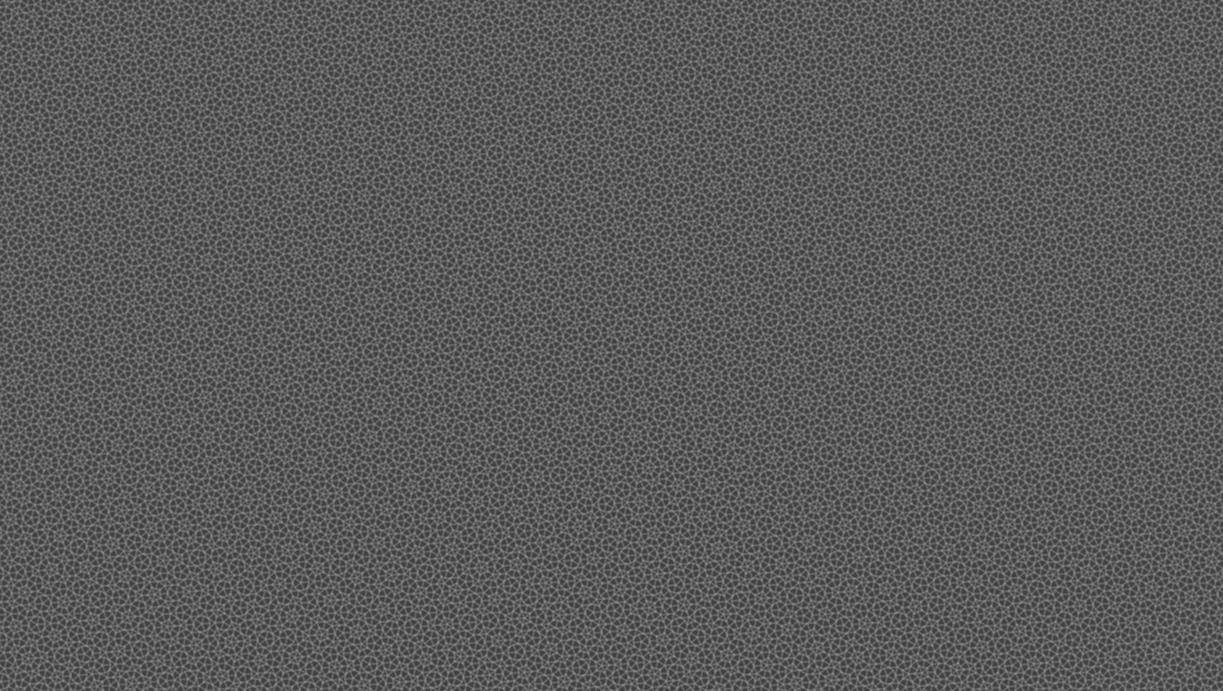
THE IMPOSSIBLE TILING
How symmetry arises from aperiodic chaos

Slide 2
Periodic Tiles
Properties:
Translational symmetry: There exists a vector T such that moving the entire pattern by T leaves it unchanged.
Lattice structure: Any point on the pattern can be represented by a lattice vector. The entire pattern can be generated using the lattice vector and the finite unit cell.
Possible symmetries:
I. Rotational symmetry: Rotate along a fixed axis, 2 fold(180deg), 3 fold(120deg), 4 fold(90deg) and 6 fold (60deg).
II. Reflection symmetry: Mirror symmetry.
III. Glide symmetry: Mirror symmetry + Translational shift (footsteps on the beach).

Slide 3
There are infinite number of shapes that can tile the plane periodically and another infinite which can tile it both periodically and non-periodically but the question was: Can there be a tile that tiles the plane only non-periodically?
Under the given condition, it should be a finite set of tiles which is infinitely repeating; such a tiling pattern is called aperiodic tiling.
Wang’s Conjecture:
If it can tile the plane, it will do so periodically. (Completely false.)

Slide 4
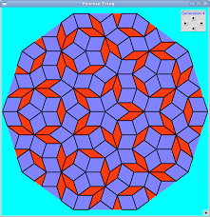
Such a tiling is penrose tiling.
Penrose Tiling is a non-repeating (aperiodic) pattern that still completely covers a plane. It was discovered by Sir Roger Penrose in the 1970s and shows how order can exist without periodic repetition.
Rhombus pattern:
This pattern uses thick and thin rhombi.
Have you seen this in our campus?

Slide 5
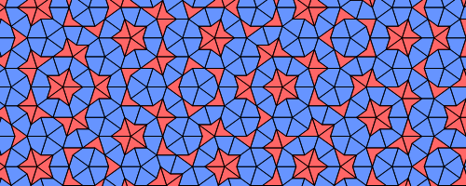
The Golden Ratio
The Golden Ratio is a mathematical proportion often found in nature and used in art and design to create aesthetically pleasing and balanced compositions.
When a finite part of this pattern is taken, the ratio between
the number of kites to the number of darts gives the golden
Ratio; which is approximately 1.618.
When we count up the long and short spacings in the Amman
Bars, we get the Fibonacci sequence which also approximates to the golden ratio.

Slide 6
Real World Applications
Quasicrystals: Atomic structures which match Penrose like ordering in three dimensions. These are used to make non-stick frying equipment and surgical instruments.
Architecture: Unique floor and wall designs (Interesting fact: Some tilings appear in Islamic art, centuries before Penrose).
Mathematics and Physics: Used in research, symmetry breaking and quantum ordering.
Computer Graphics: Algorithm pattern generation and encryption schemes.
Fun fact: In 2023, aperiodic tiling was achieved by a single shape. This shape is a 13 sided figure known as the Einstein tile.

